Slide 1
RESULT IMAGES/OUTPUT IMAGES

Slide 2
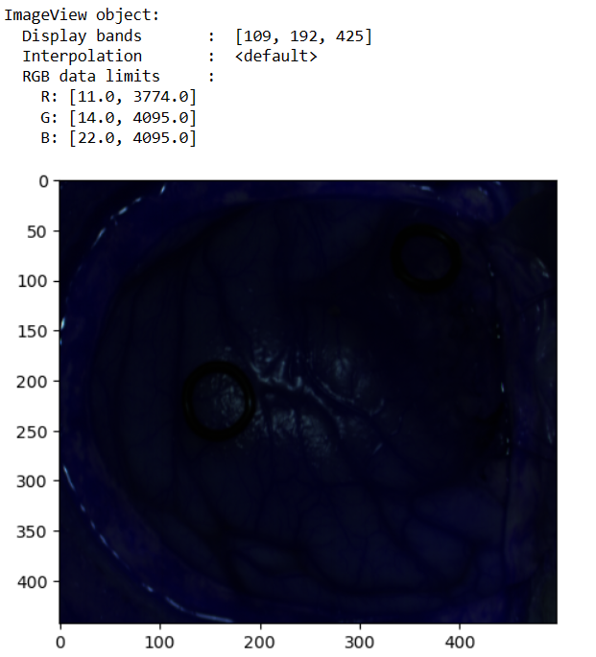
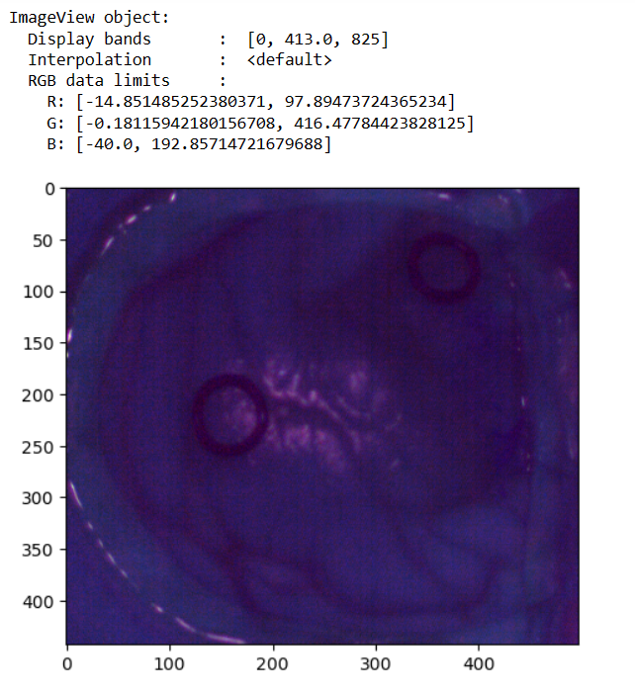
Raw image
Calibrated image

Slide 3
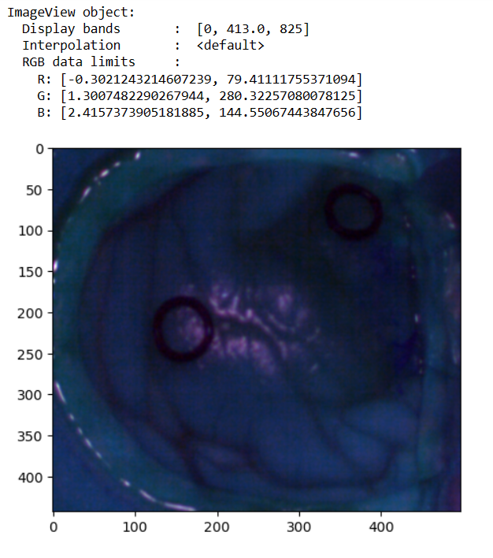
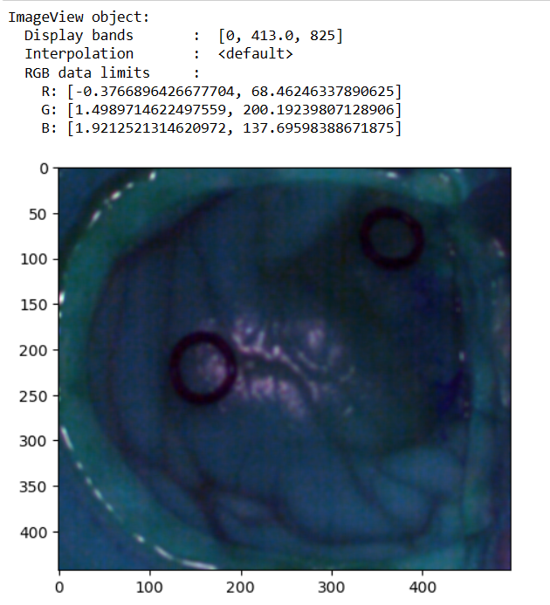
Noise filtered images
Calibrated image
Gaussian filtered image
HYSIME filtered image

Slide 4
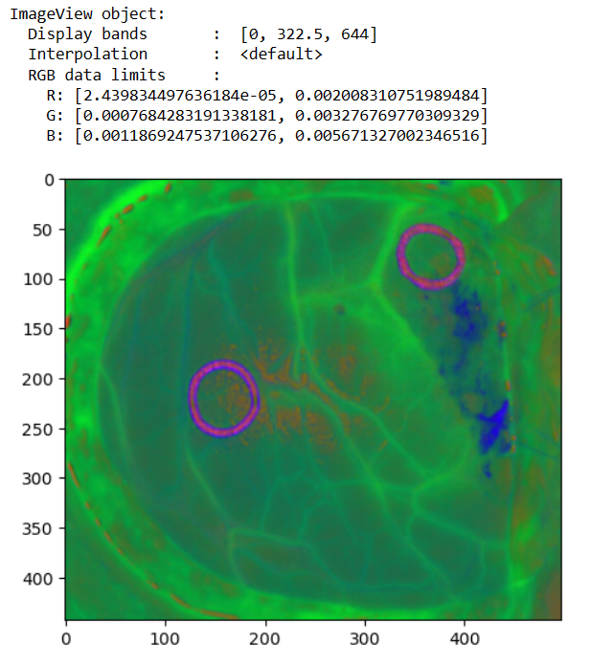
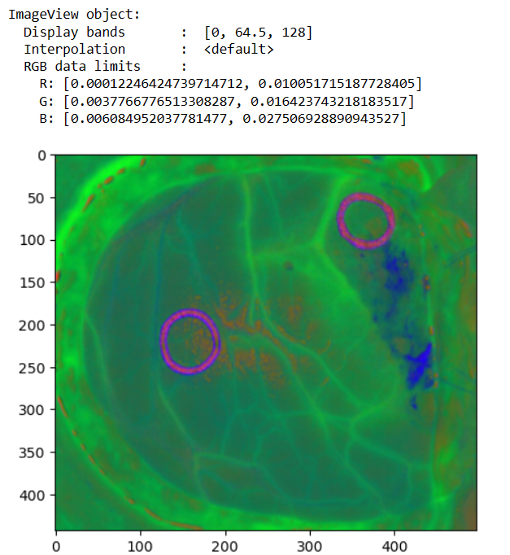
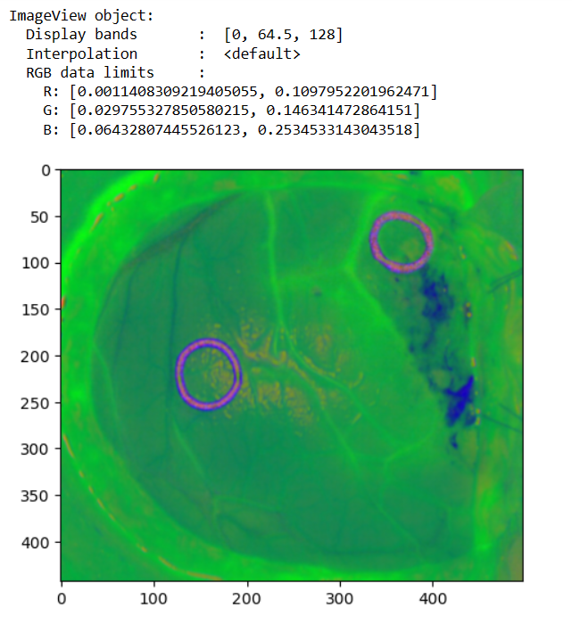
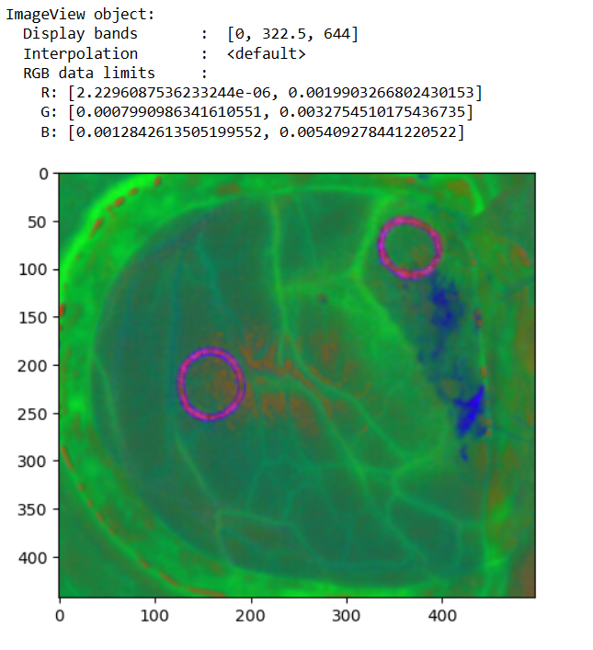
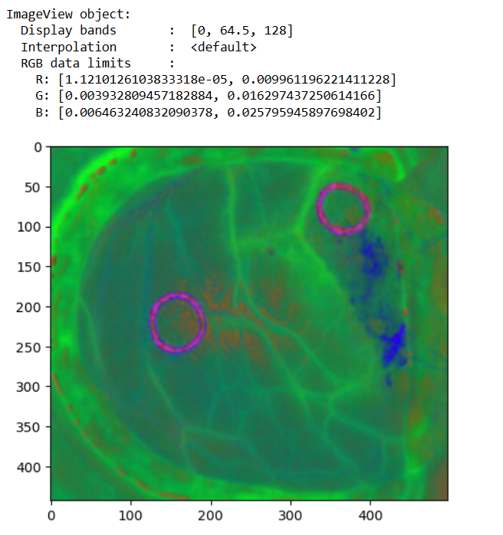
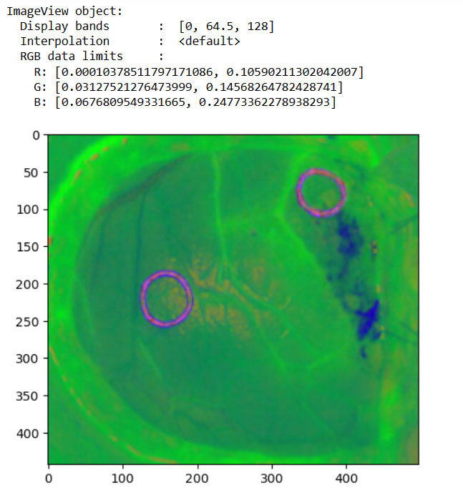
Brightness normalized images
Gaussian filtered image(with out decimation)
Gaussian Decimated image
Gaussian Decimated image( using Different code )
HYSIME filtered image(without decimation)
HYSIME Decimated image
HYSIME Decimated image (using Different code)

Slide 5
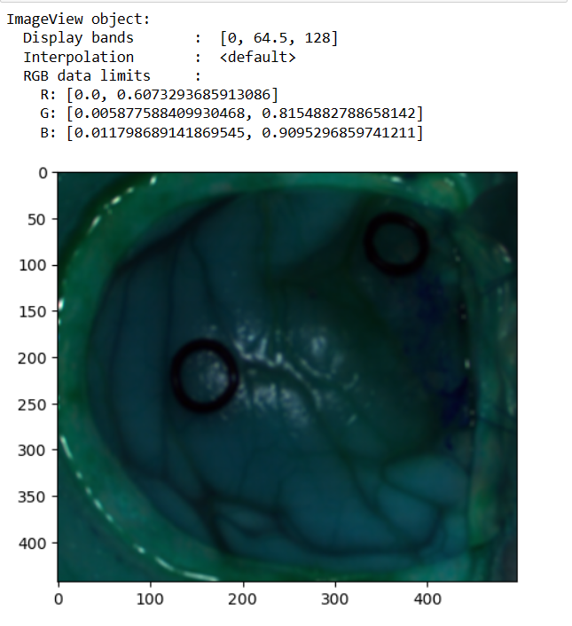
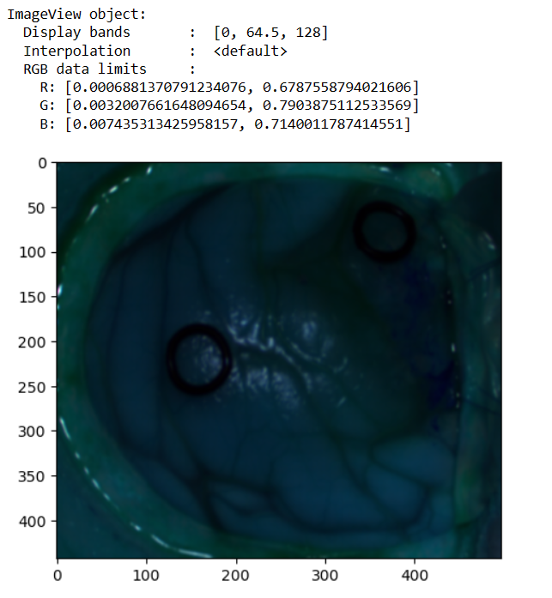
Standard Normalized Images
Gaussian filtered image
HYSIME filtered image

Slide 6
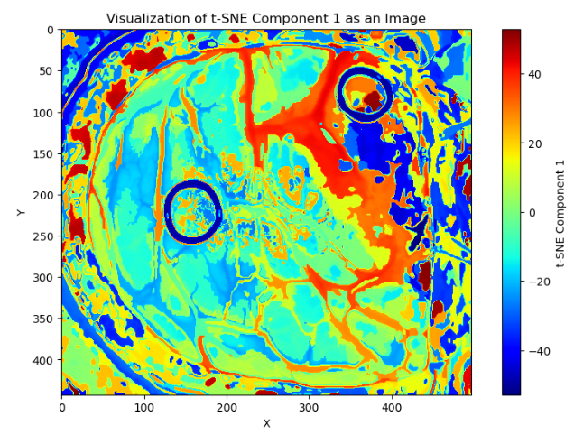
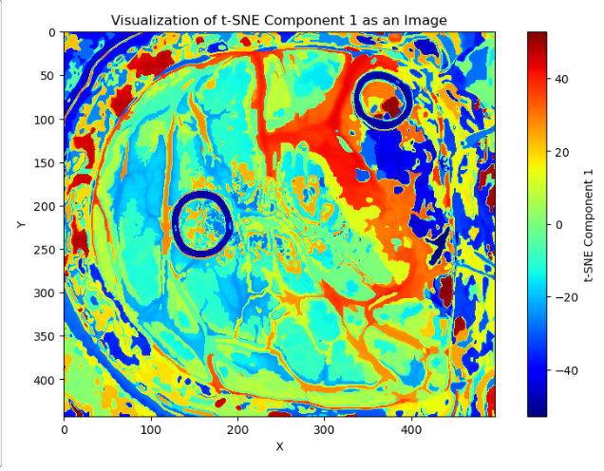
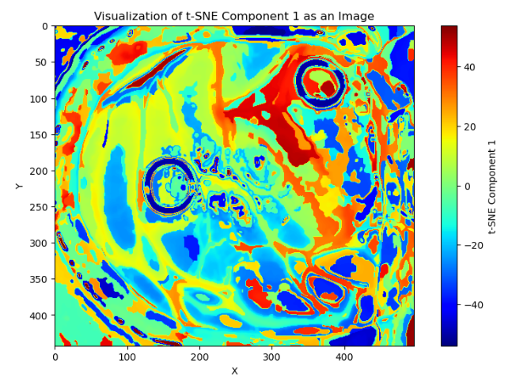
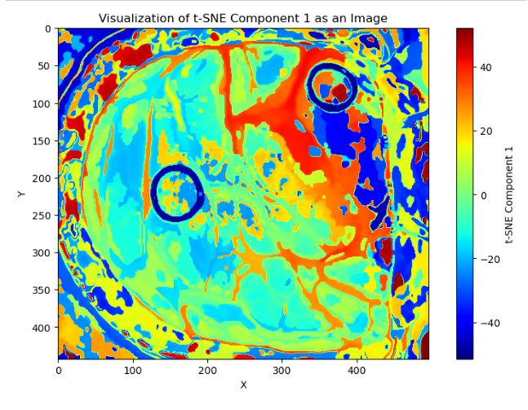
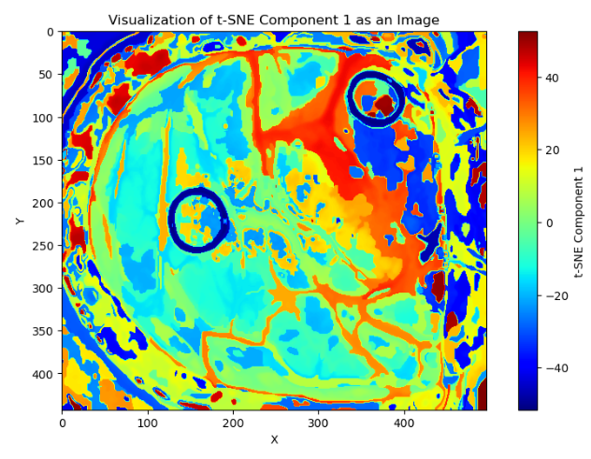
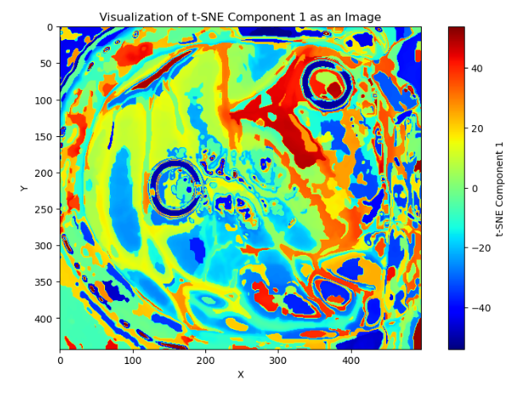
T-SNE (One band representation)
Gaussian bright normalized without decimation
Gaussian different normalized(with decimation)
Gaussian without decimation using standard normalization
HYSIME bright normalized without decimation
HYSIME different normalized(with decimation)
HYSIME without decimation using standard normalization

Slide 7
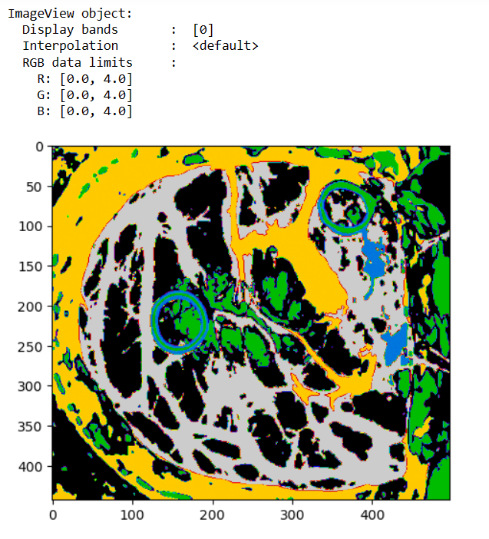
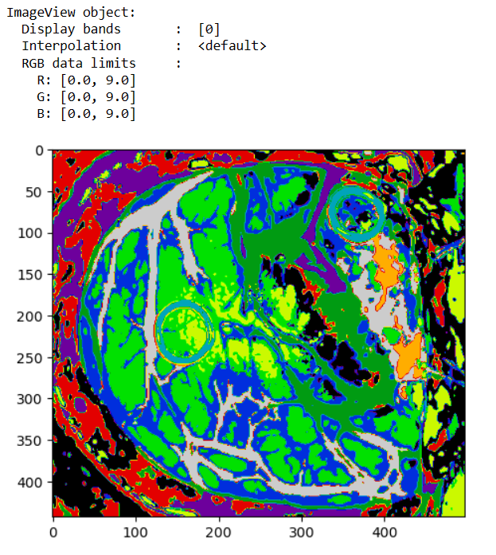
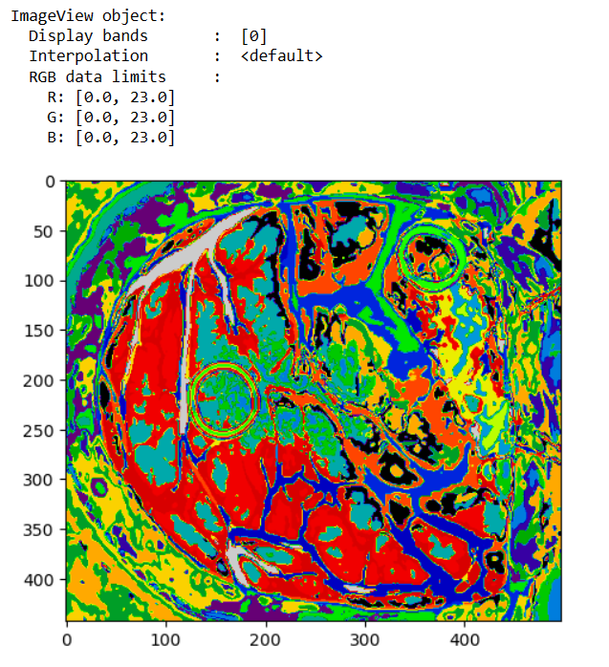
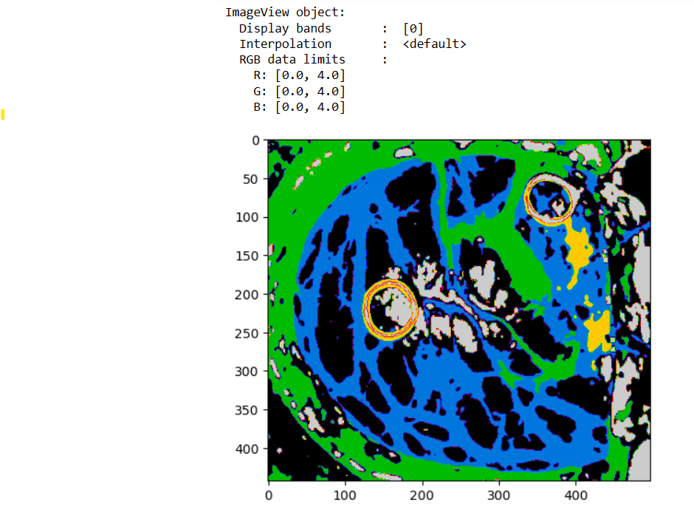
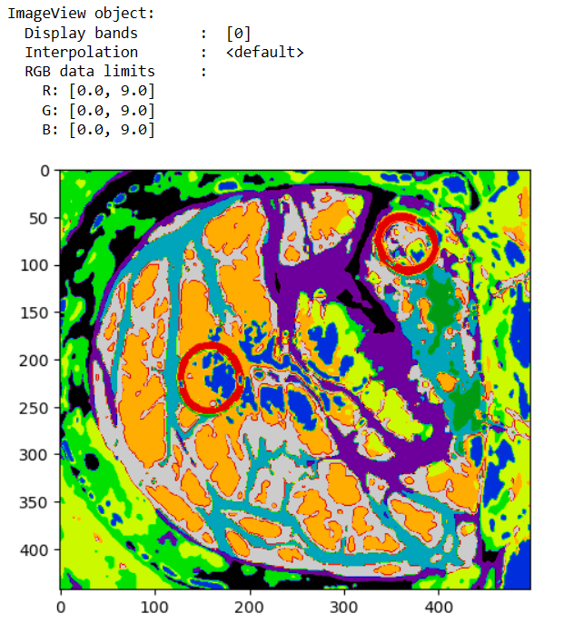
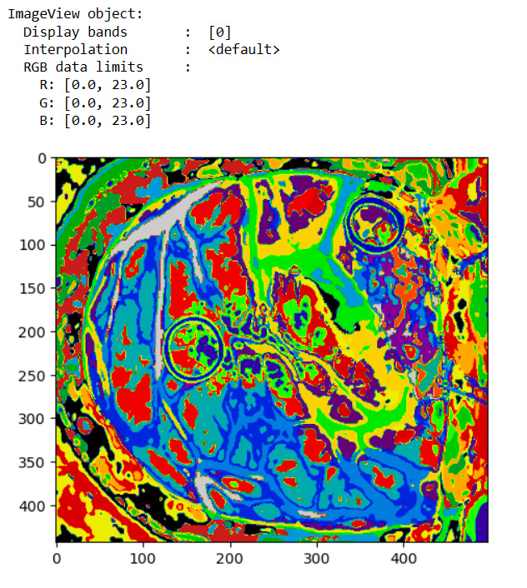
Clustering images (brightness normalized)
Gaussian filtered
5 clusters
10 clusters
24 clusters
Hysime filtered
5 clusters
10 clusters
24 clusters

Slide 8
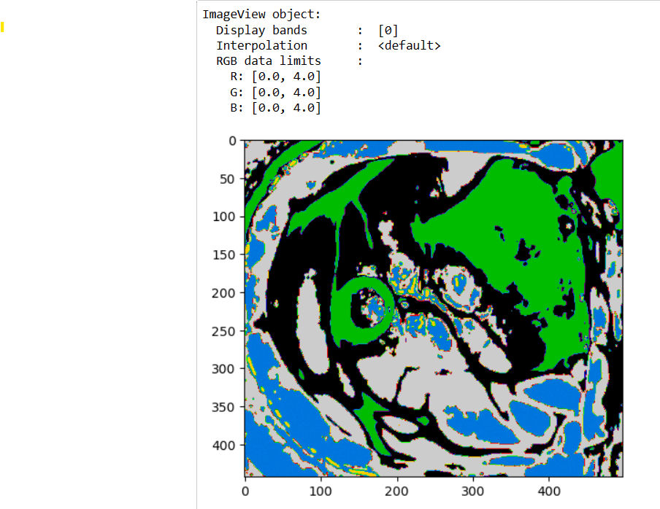
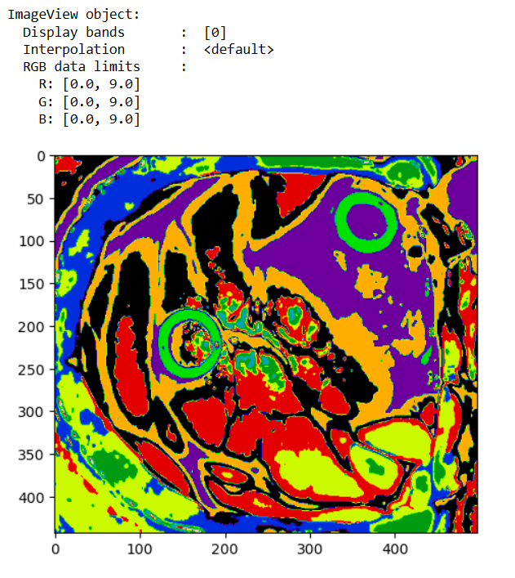
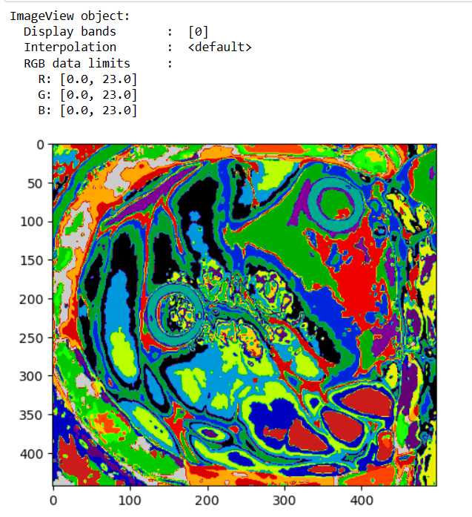
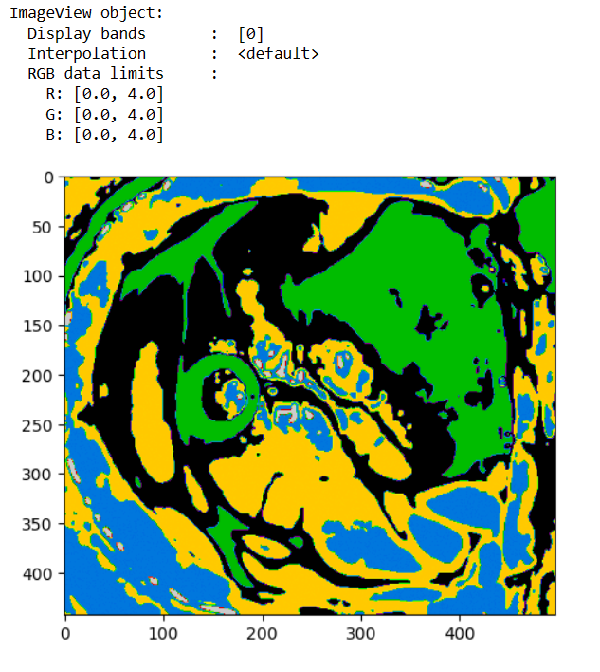
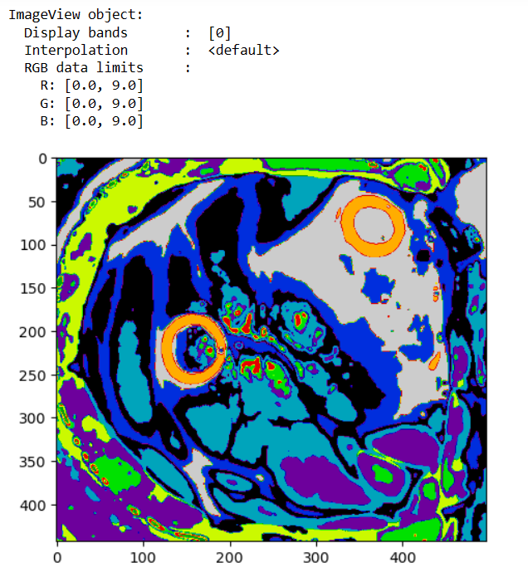
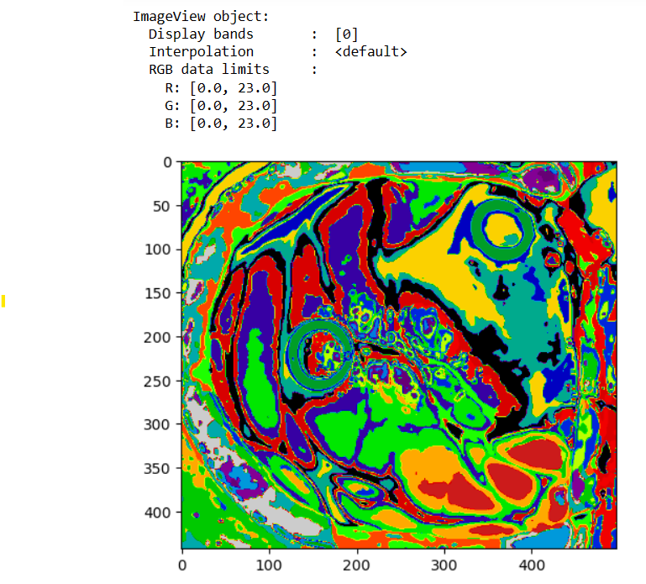
Clustered images(Standard Normalization)
Gaussian filtered
5 clusters
10 clusters
24 clusters
Hysime filtered
5 clusters
10 clusters
24 clusters

Slide 9
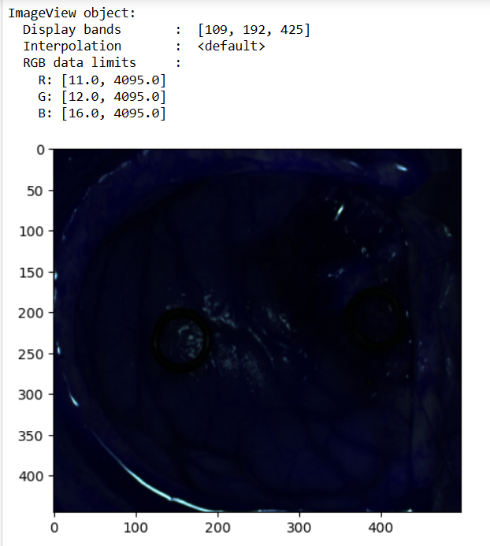
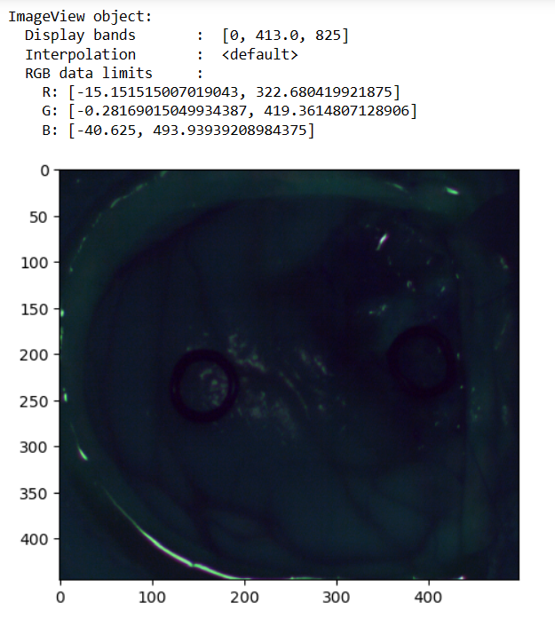
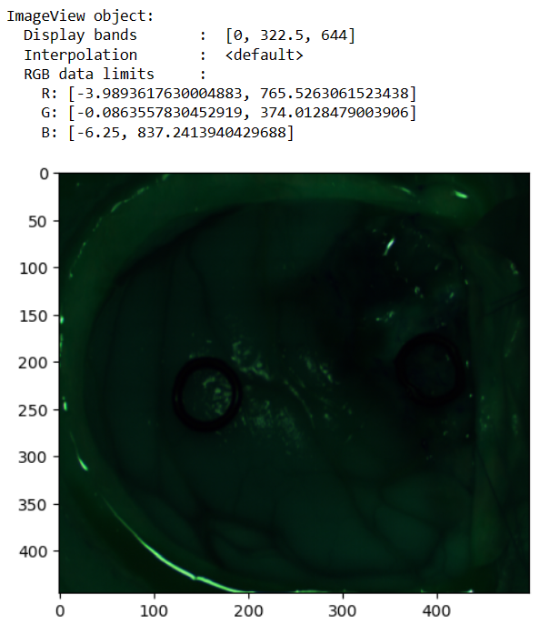
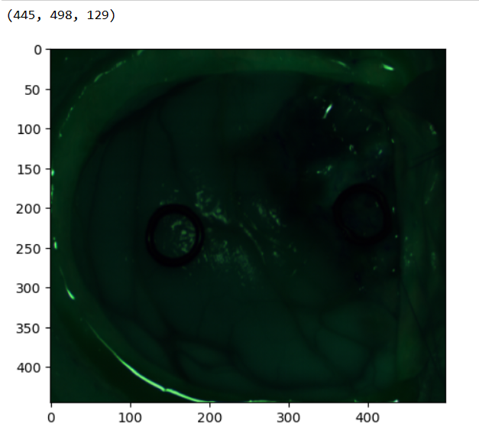
Final result images
Preprocessed images :
Raw image
Calibrated image
Image after removal of extreme bands
Decimated image

Slide 10
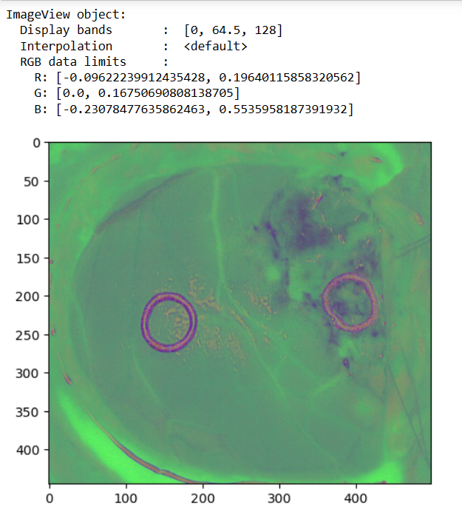
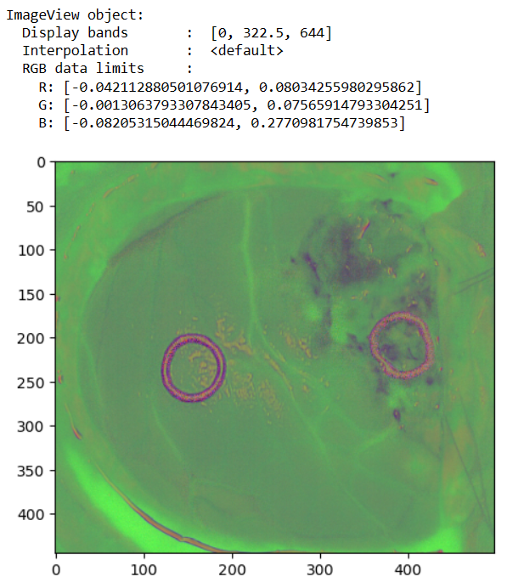
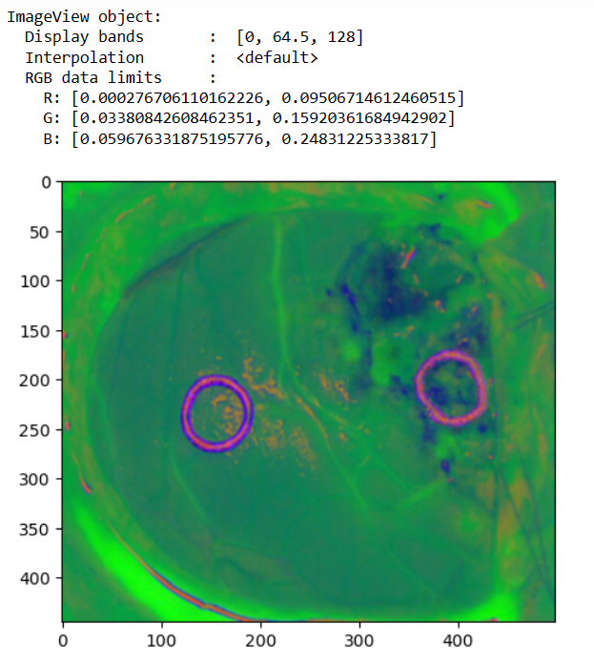
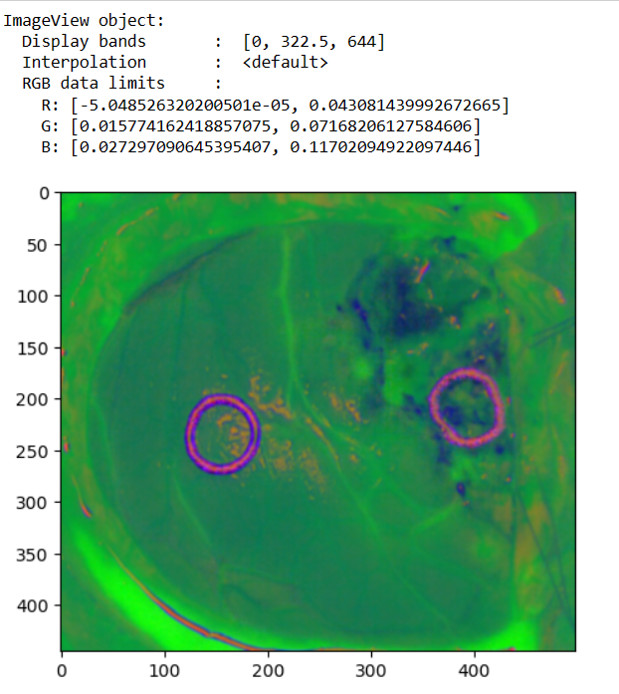
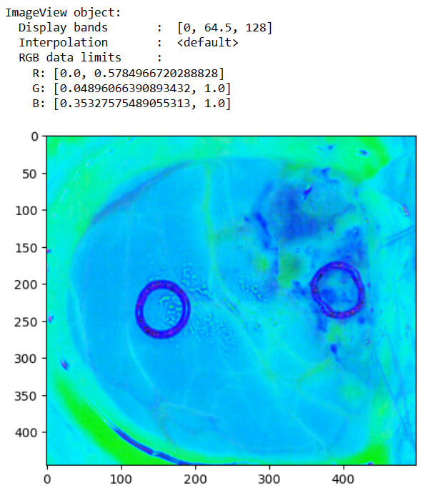
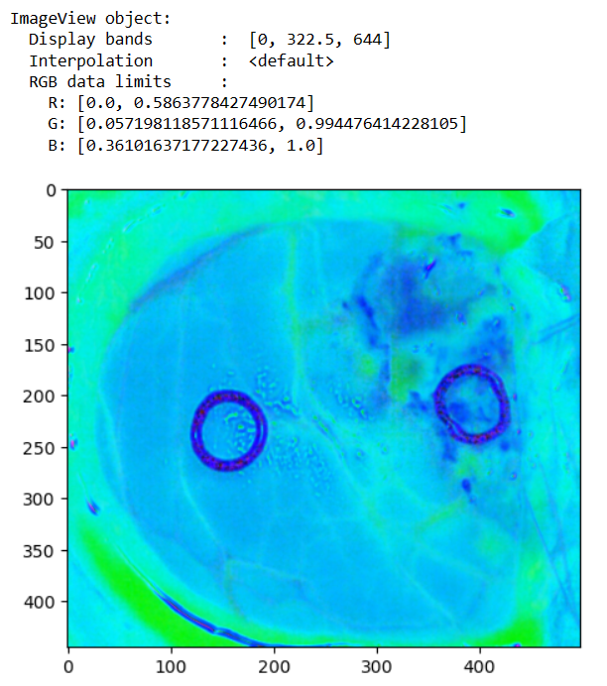
Data : 012-01
With decimation without decimation
Brightness normalized
Gaussian filtered image
Min-max normalized image

Slide 11
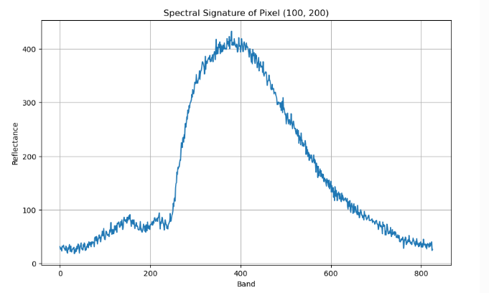
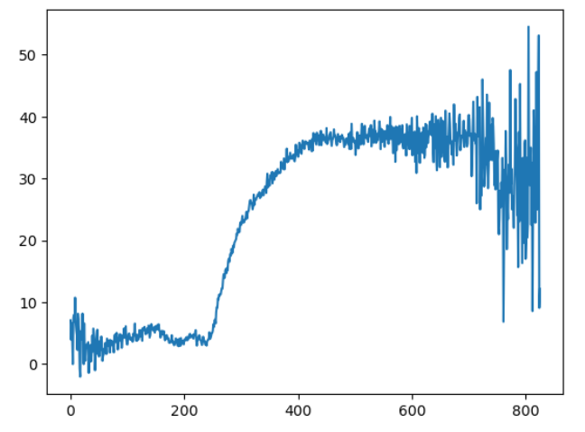
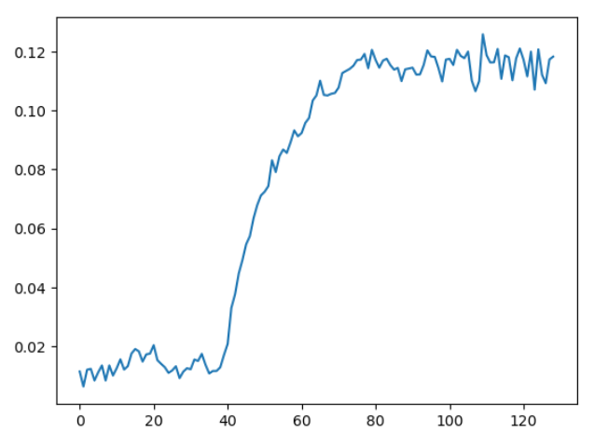
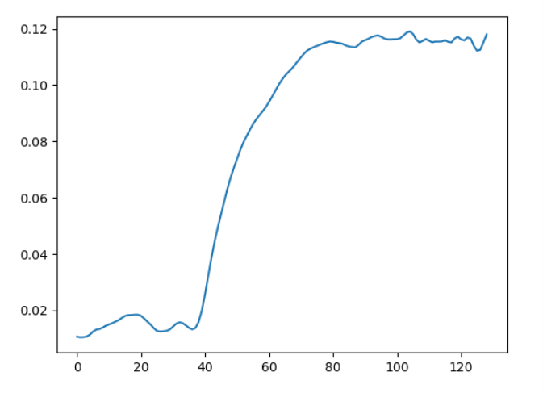
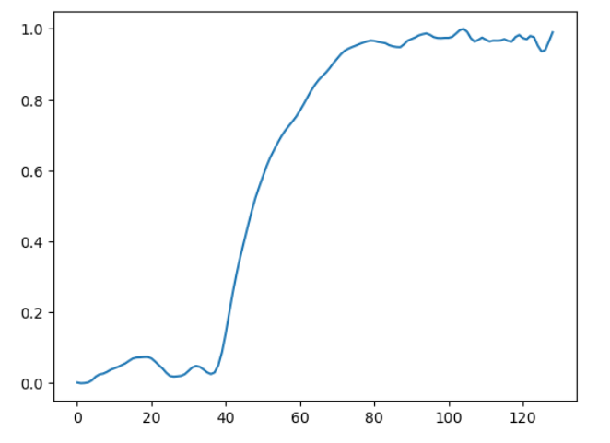
Spectral signatures
Raw image
Calibrated image
Brightness normalized image
Gaussian filtered image
Normalized image

Slide 12
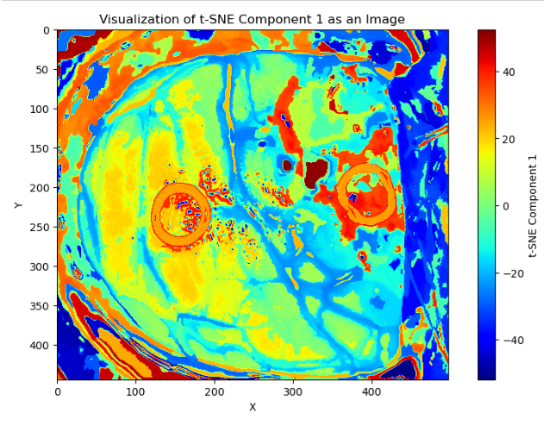
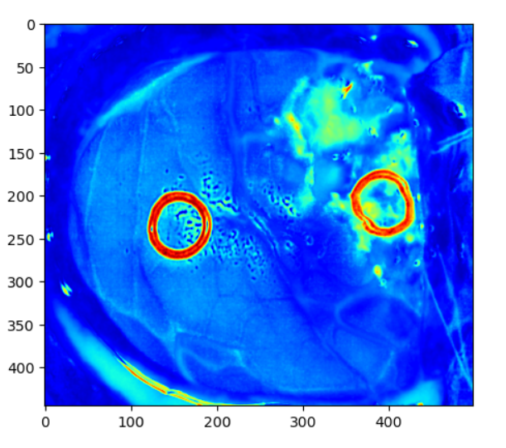
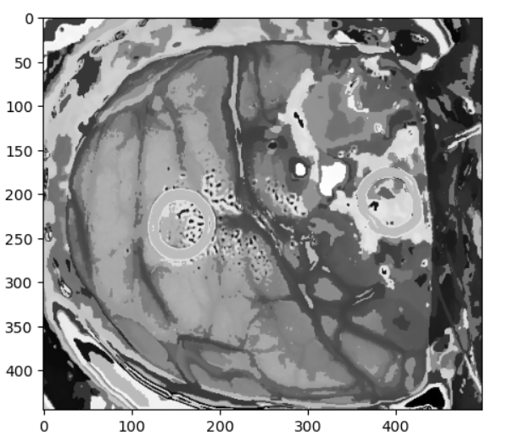
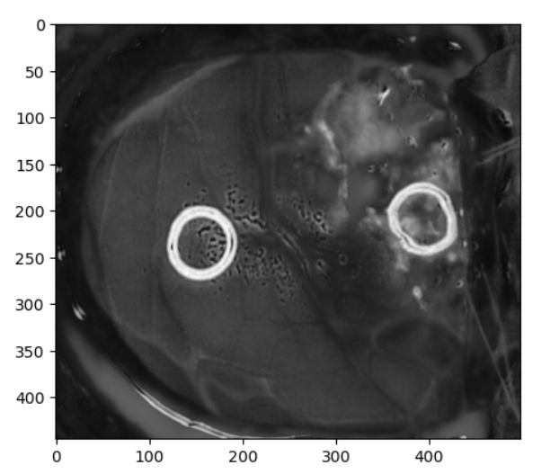
One band representation:
T-SNE
PCA

Slide 13
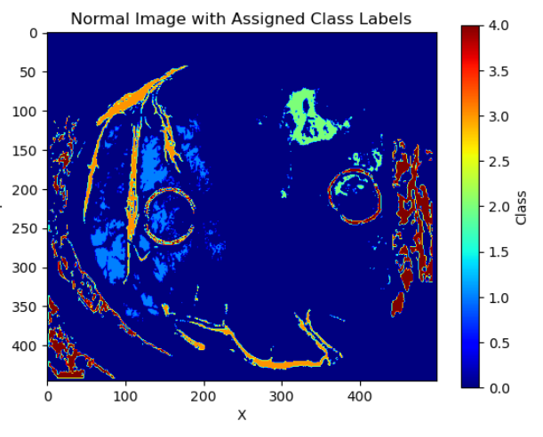
Supervised classification map:

Slide 14


KNN filtered Map
Using t-SNE
Using PCA

Slide 15



Unsupervised clustering: k-means
5 clusters
15 clusters
24 clusters

Slide 16






Majority voting images :
t-SNE used
PCA used
5 Clustered map used
15 clustered map used
24 clustered map used

